Slide 1
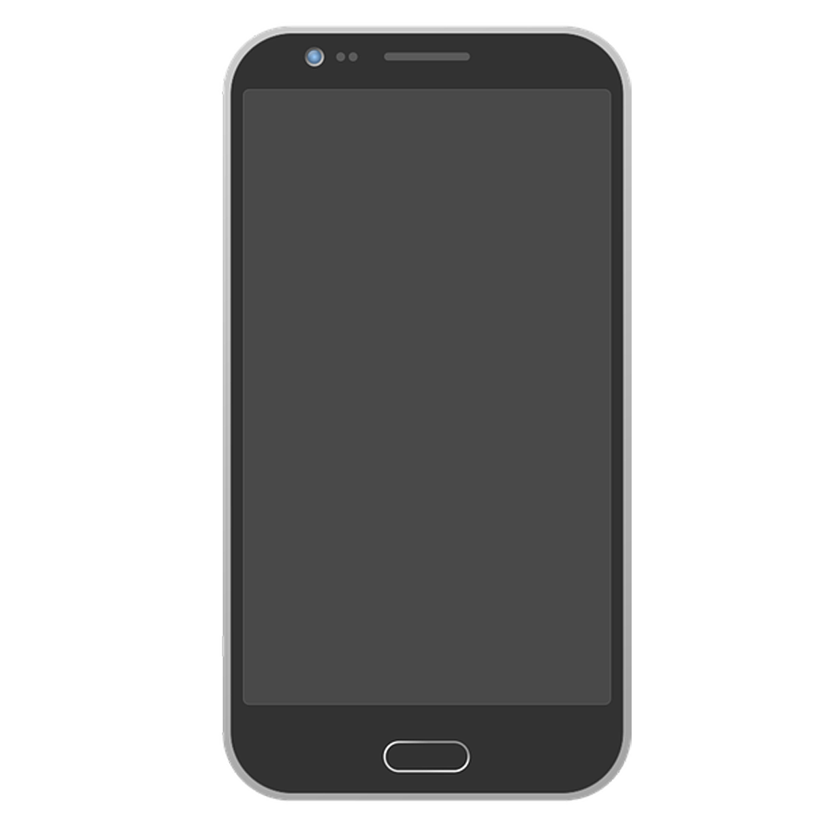
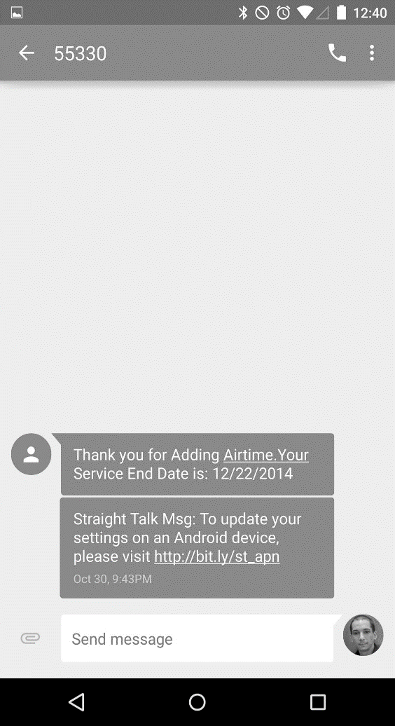
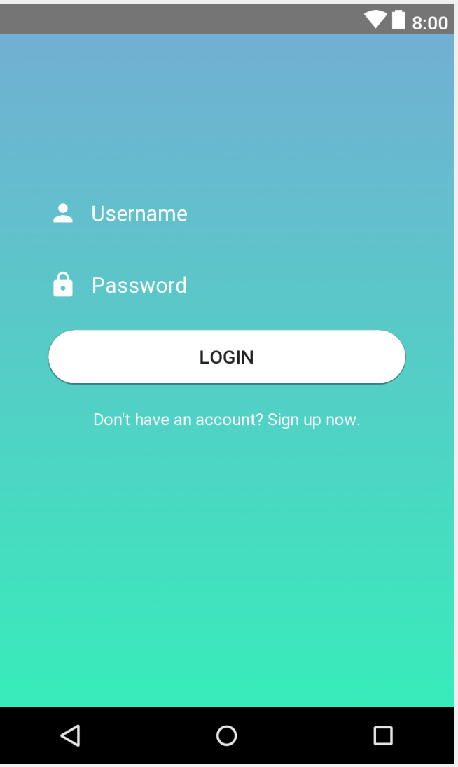
Emoji Checker
TEAM EMOJENIUS
Avneet Sethi, Riyan Imam,
Michael Wheeler, Jocelyn Lopez,
Storm Simpson

Slide 2

The Emoji Checker App
Product:
Records and logs students’ feelings towards the current lecture through a seamless user interface
Allows students to view their previous responses/emojis to better prepare for their courses/upcoming tests
Value:
Serves as a data analysis tool for professors to enhance the students’ learning experience by changing the classroom setting
Keeps students engaged

Slide 3
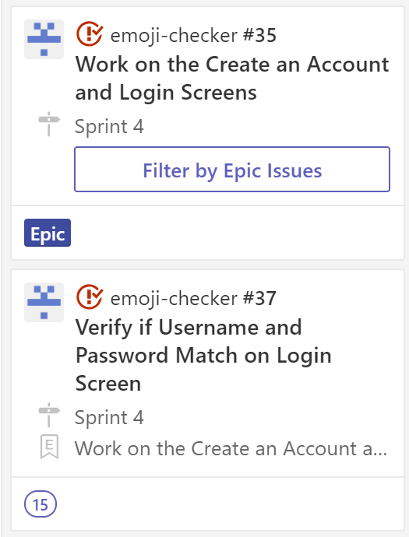
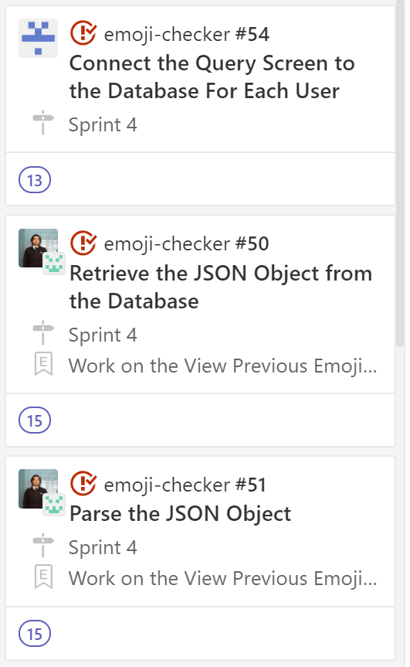
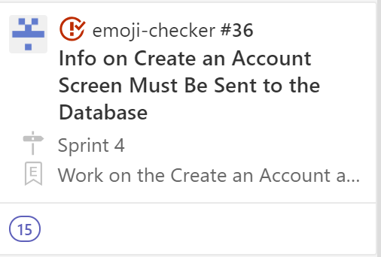
The Story So Far …
Completed Story Cards
Connect Register and Login screens to the database
Connect the query screen to the database for all users
Generate and save authorization token for each user
Parse information from database to view previous emojis

Slide 4
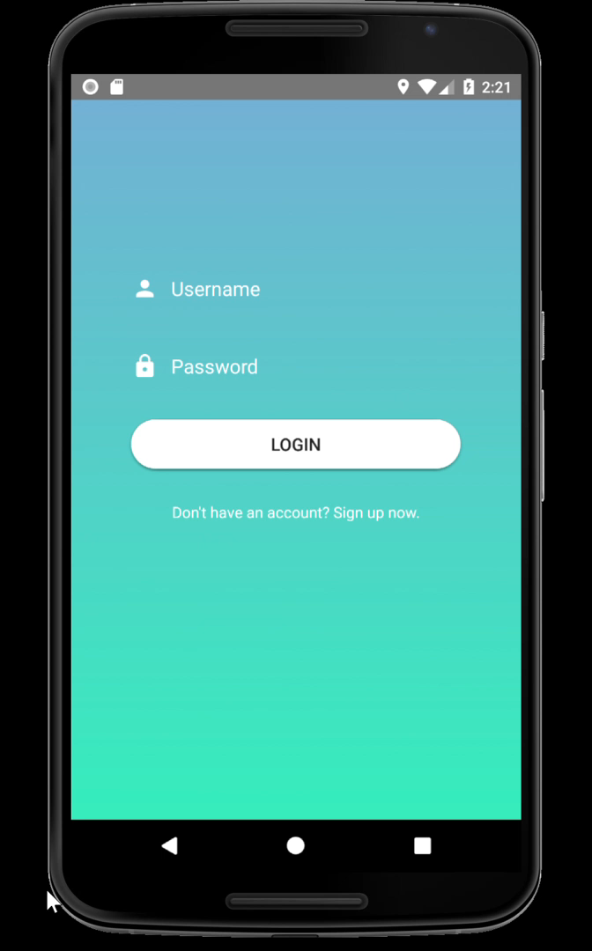
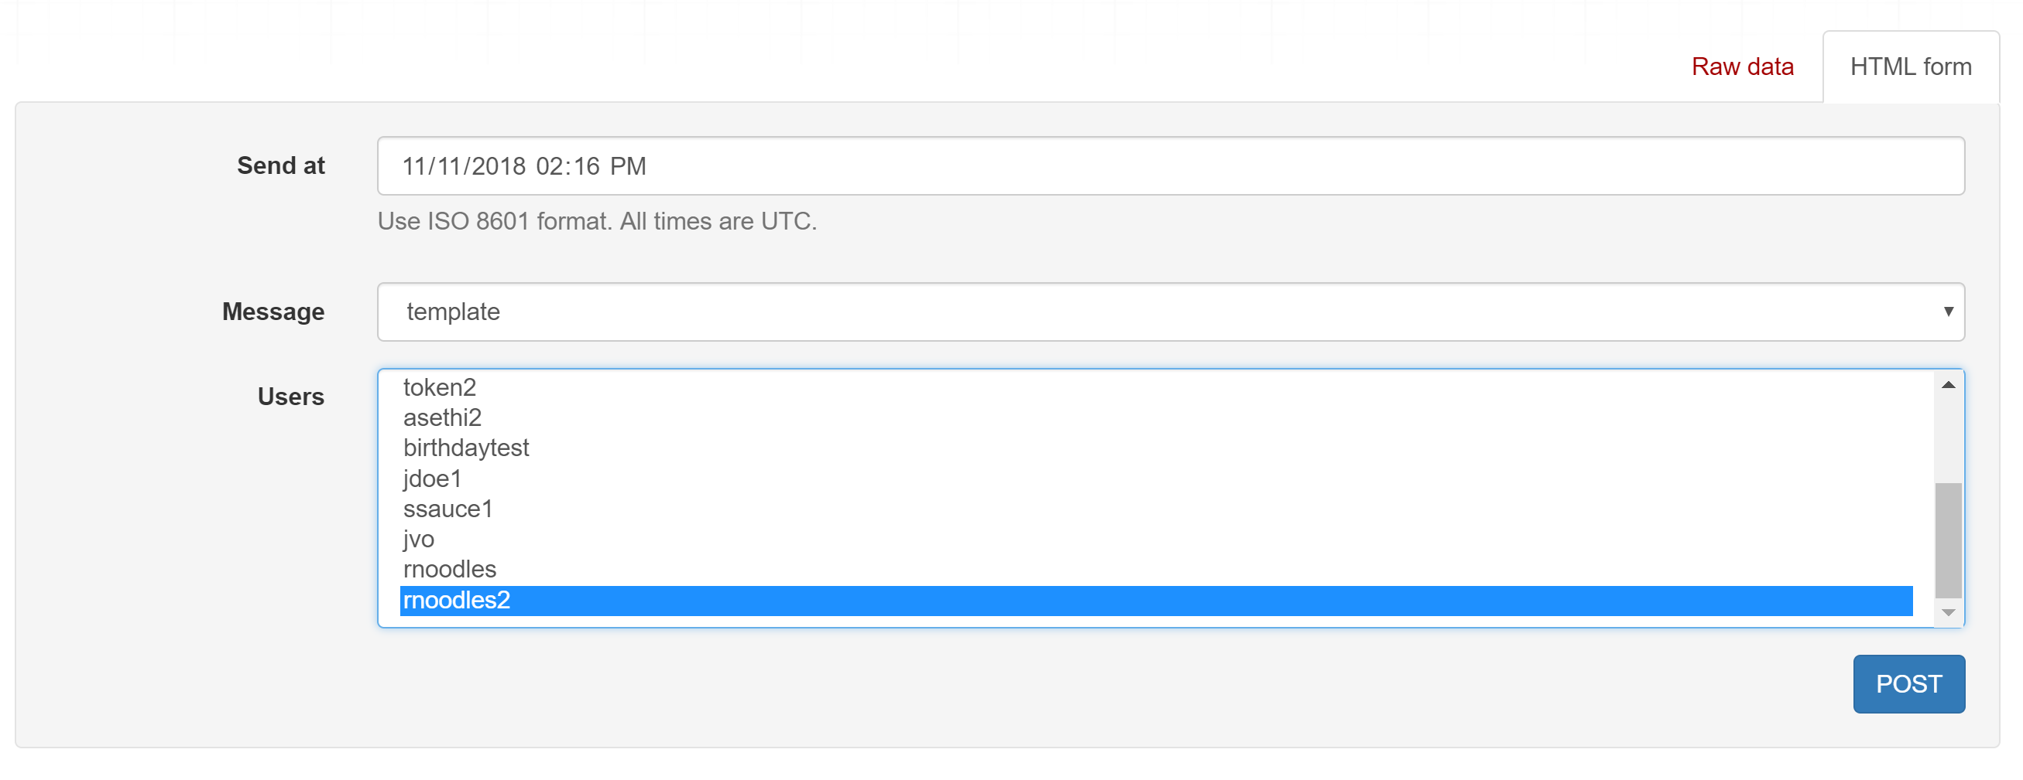
The Story So Far …
We can now select specific users from the endpoint by sending a message that activates the 10 minute window for them to send an emoji. If the user is not selected, they cannot send an emoji to the server and will get an HTTP 500 Response Error Code.

Slide 5
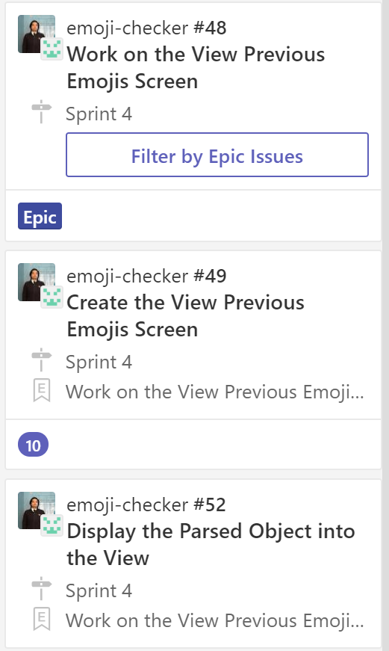
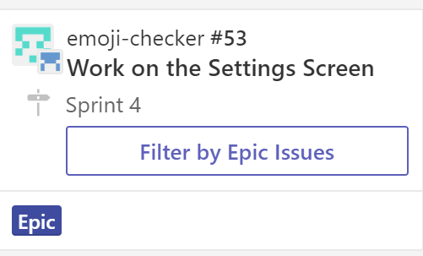
Backlog
Account Settings Screen
User should be able to change their password and phone number and these changes should be updated into the database.
Parsing response for View Previous Emojis Screen

Slide 6
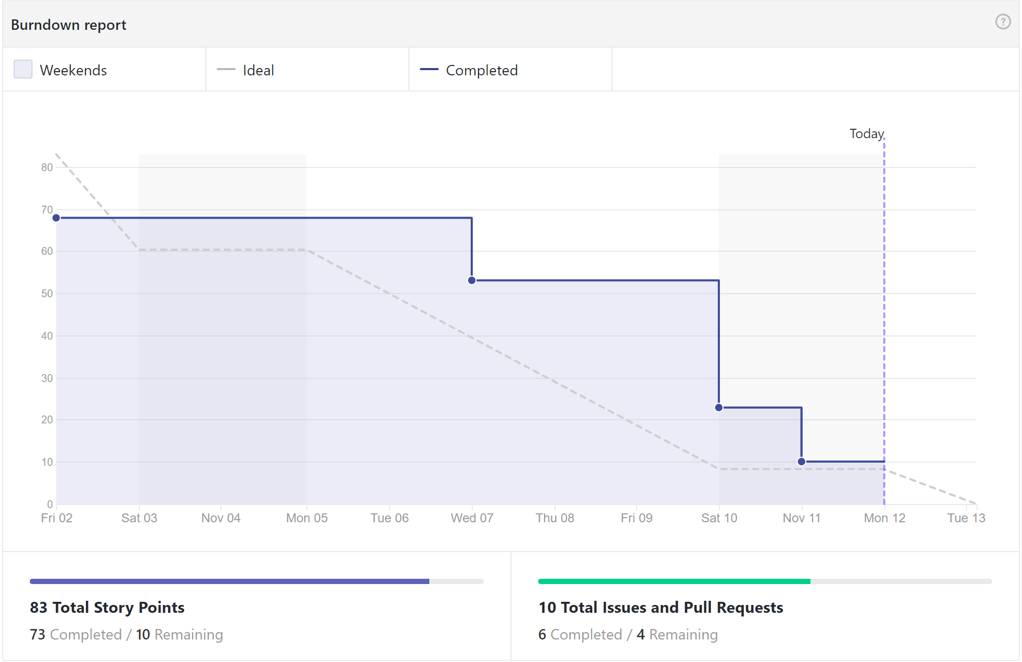

Slide 7
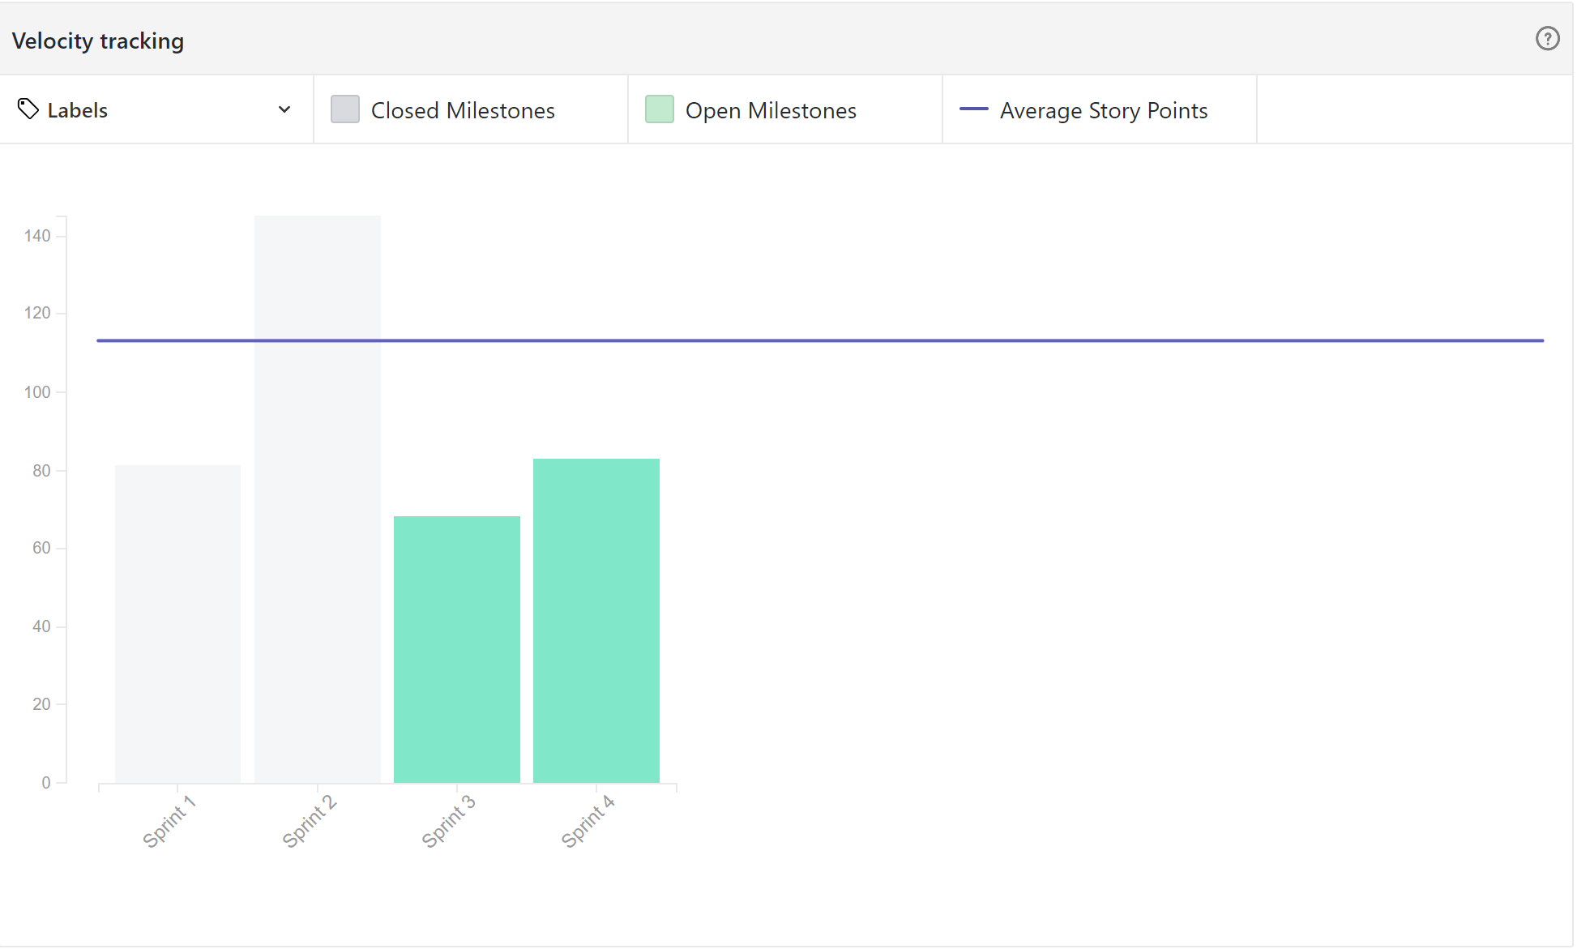

Slide 8
Test Cases

Slide 9
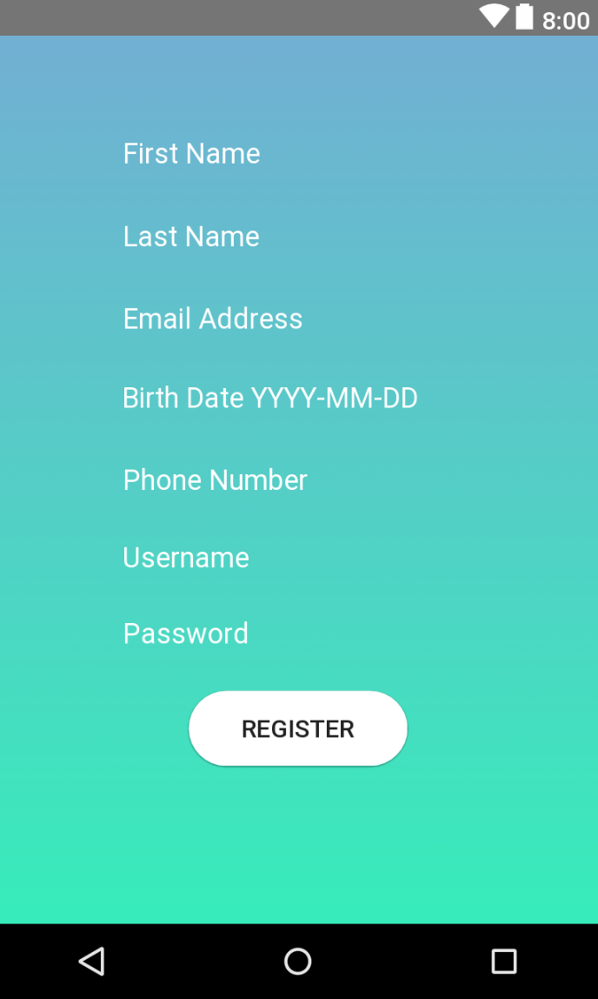
Create an Account Screen
Pam wants to use the Emoji Checker app. She needs to create an account in the system. Each field has restrictions on what the user can or cannot enter.
Is the password 8 or more characters in size?
Does the system display an error message if the username already exists?
Does the system display an error message to the user if they do not enter their birth date in the following format: YYYY-MM-DD?
Is the phone number in E164 format?
Does the system redirect the user to the login screen after they have successfully submitted the form?

Slide 10
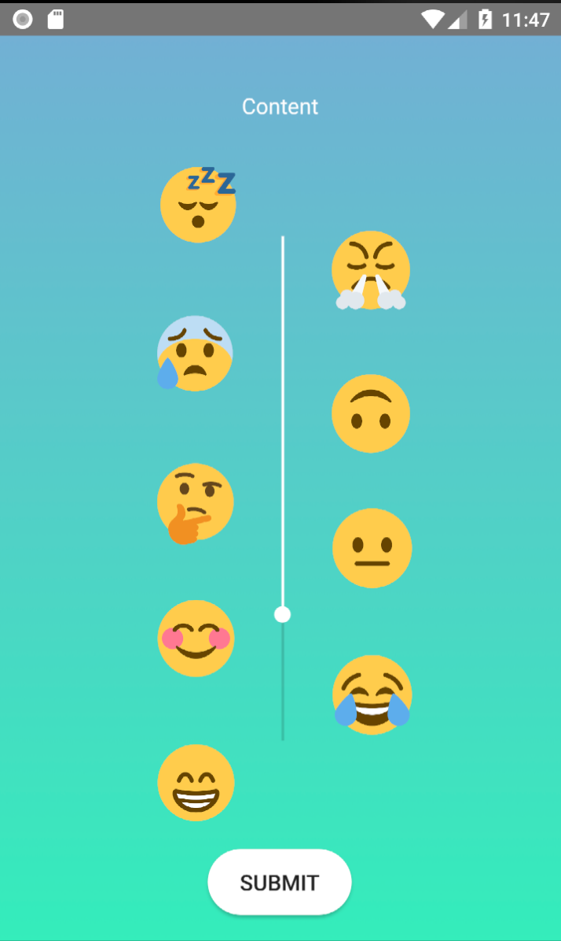
Query Screen
After receiving a notification to query, Pam would now like to submit her emoji through the Emoji Checker App. She must use the slider to select the emoji.
Does the slider express a range of emotions from sad to happy (similar to a Likert scale)?
Is there a description that identifies the emoji that has been selected?
Does the system accept a response from a user who has not been selected to query?
Does the system display a confirmation message upon successfully receiving the emoji?
Does the system display an error message upon encountering a server error?

Slide 11

Plans for Sprint 5
Finalize the Account Settings screen
Enable change password and phone number functionalities
Finalize the View Previous Emojis screen
Add Account Settings, View Previous Emojis, and Query to the Navigation Panel
Maintain the user flow between app screens

